Slide 1
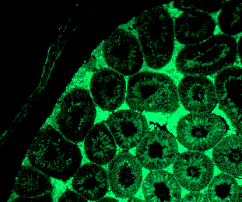
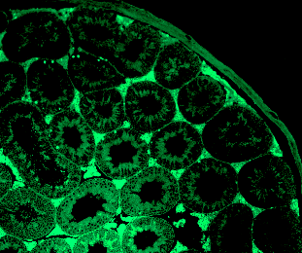
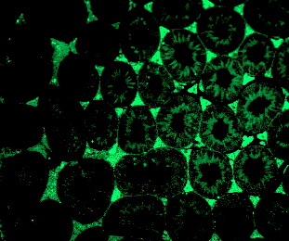
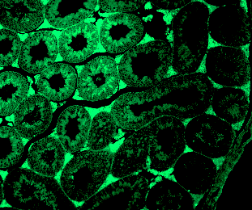
FSH2Md and
LH2Auristatin 554
Total tubules | Average apoptotic cells/ tubule | Tubules with apoptotic cells
66 | 3 | 16

Slide 2
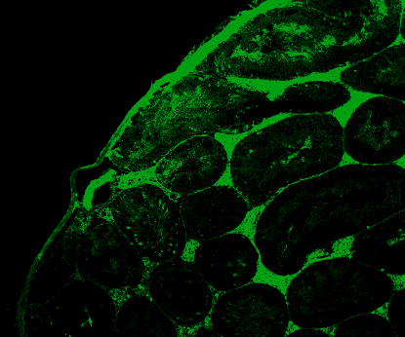
FSH2Md and
LH2Auristatin 530
Total tubules | Average apoptotic cells/ tubule | Tubules with apoptotic cells
49 | 4 | 16

Slide 3
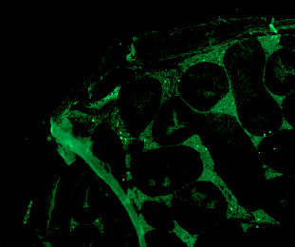
FSH2Md and
LH2Auristatin 508
Total tubules | Average apoptotic cells/ tubule | Tubules with apoptotic cells
41 | 4.25 | 8

Slide 4
FSH2Md and
LH2Auristatin 531 A and B
Total tubules | Average apoptotic cells/ tubule | Tubules with apoptotic cells
76 | 3.5 | 51

Slide 5
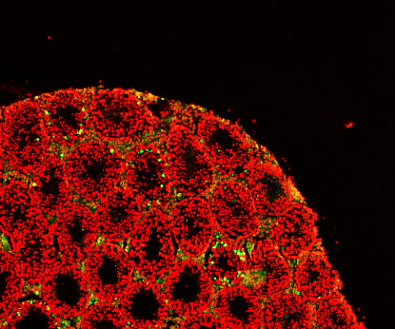
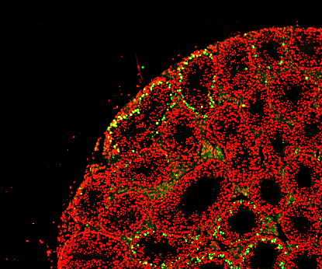
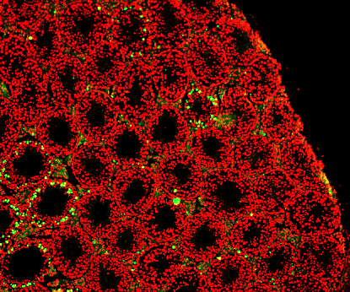
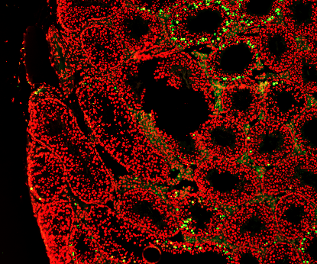
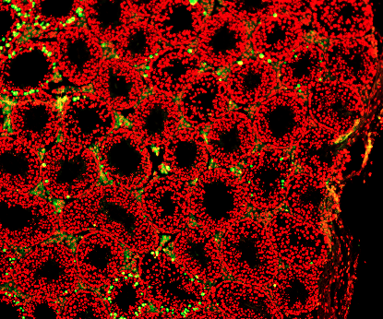
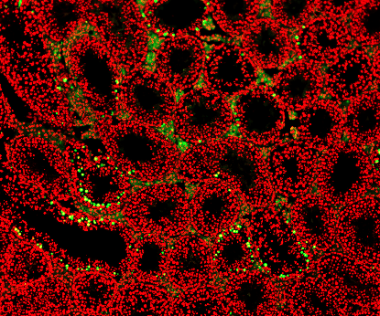
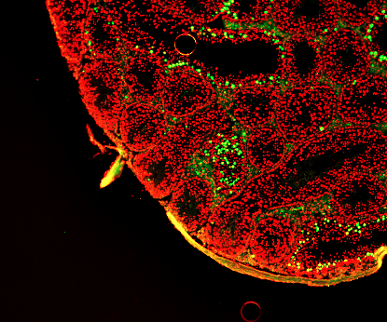
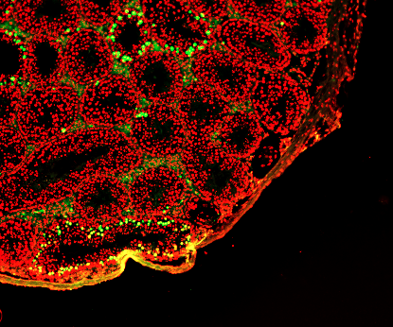
FSH2Md and
LH2Auristatin 532
Total tubules | Average apoptotic cells/ tubule | Tubules with apoptotic cells
109 | 13.8 | 54

Slide 6
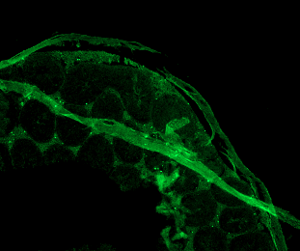
FSH2Md and
LH2Auristatin 529
Total tubules | Average apoptotic cells/ tubule | Tubules with apoptotic cells
82 | 9.5 | 41

